Slide 1


Big Data Analytics
Itroduction to Big Data

Slide 2
Big Data Analytics
Module 1: Introduction to Big data
Module 2 : Hadoop Module 3 : NoSQL
Module 4: MapReduce and New S/w Stack Module 5 : Finding similar Items
Module 6 : Mining Data Stream
Module 7 : Link Analysis Module 8: Frequent item set Module 9 : Clustering
Module 10 : Recommendation system Module 11: Mining Social-Networks Graphs

Slide 3



Outline
Introduction to Big Data Big Data Characteristics Types of Big Data
Traditional vs. Big Data Business Approach What’s driving Big Data
Issues in Big Data
Case Study of Big Data Solutions
Tell me and I forget.
Show me and I remember. Let me do and I understand.

Slide 4

Introduction to Big Data
No single standard definition… “Big Data” is data
Whose scale, diversity, and complexity require new architecture, techniques, algorithms, & analytics to manage it and extract value & hidden knowledge from it…
“Big data refers to data sets whose size is beyond the ability of typical database software tools to capture, store, manage and analyze.” - The McKinsey Global Institute, 2012

Slide 5
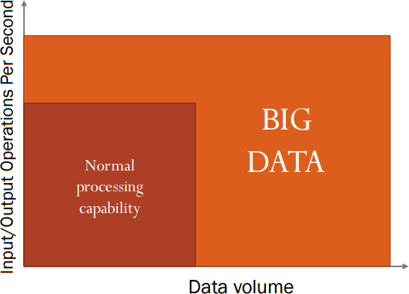
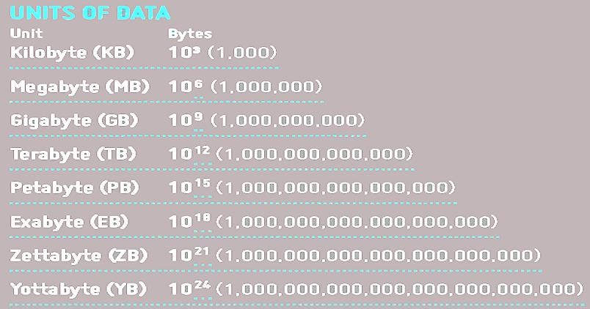
Introduction to Big Data
When data become “Big”?

Slide 6

Introduction to Big Data
How much is a zettabyte?
1,000,000,000,000,000,000,000 bytes
A stack of 1TB hard disks that is 25,400 km high How many data in a day?
7 TB (Twitter)
10 TB (Facebook)
90% of world's data: generated over last two years!

Slide 7
Introduction to Big Data
A simple example of a big data process
Problem: The sale in a town!
Acquisition:
Sales by customer, region and time
Surveys of users
Social networks
Extraction:
Data loading from receipts
Automatic reading of questionnaires
Data extraction from twitter
Integration:
On the basis of user types

Slide 8
Introduction to Big Data
A simple example of a big data process (Contd.)
Analysis:
lollipops bought by people older than 25
lollipops preferred by people younger than 10
Interpretation:
Moms believe: lollipops = bad teeth
Boys and girls believe that lollipops are for babies
Decision:
We make lollipops without sugar
We ask dentists to advertise our lollipops
We make commercials targeted to boys and girls

Slide 9




Introduction to Big Data
Examples Of 'Big Data'
The NYSE generates about one terabyte of new trade data per day.
Statistic shows that 500+terabytes of new data gets ingested into the databases of social media site Facebook, every day. This data is mainly generated in terms of photo and video uploads, message exchanges, putting comments etc.
Single Jet engine can generate 10+terabytes of data in 30 minutes of a flight time.
Thousand flights per day, generation of data reaches up to many Petabytes.

Slide 10
Introduction to Big Data
Benefits of Big Data Processing
Businesses can utilize outside intelligence while taking
decisions
Improved customer service
Early identification of risk to the product/services, if any Better operational efficiency

Slide 11
What to do with these data?
Aggregation and Statistics
Data warehouse and OLAP
Indexing, Searching, and Querying
Keyword based search
Pattern matching (XML/RDF-Resource Description Framework)
Knowledge discovery
Data Mining
Statistical Modeling

Slide 12
Smart Decisions
Why Big Data analysis Should Matter to Organization?
Time Reduction
Cost Reduction
New product offerings
Personalized offerings, etc.

Slide 13
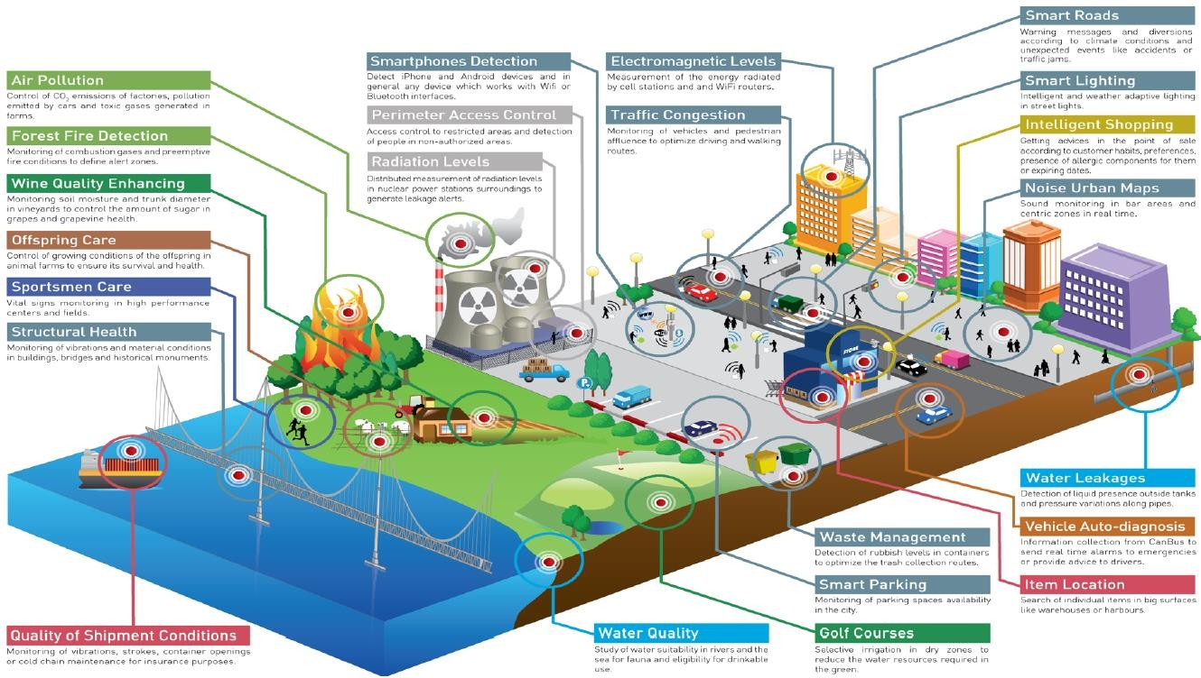
Characteristics of Big Data
Data Sources

Slide 14
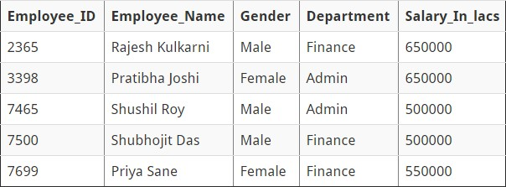
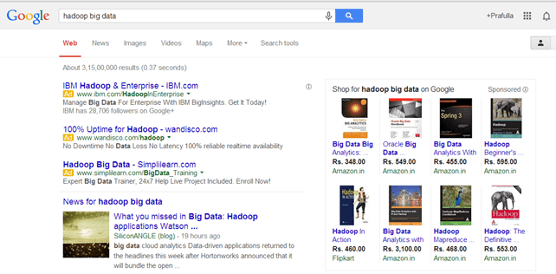
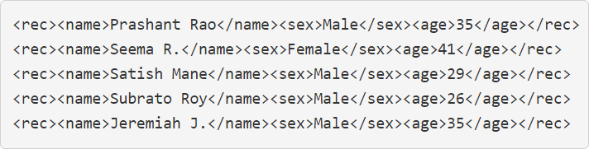
Introduction to Big Data
Categories Of ‘Big Data’
Structured (An 'Employee' table in a database) Unstructured (Output returned by 'Google Search’) Semi-structured (Personal data stored in a XML file)

Slide 15
Types of Big Data
Types of Big Data
Relational Data (Tables/Transaction/Legacy Data) Text Data (Web)
Semi-structured Data (XML) Graph Data
Social Network
Semantic Web (RDF-Resource Description Framework)
Streaming Data
You can only scan the data once

Slide 16
Introduction to Big Data
What is more important?
The “Big”
The “Data”
Both
Neither

Slide 17
Introduction to Big Data
Answer

Slide 18
5 v’s of big data
Volume
Velocity
Varity
Collection of the data generated globally
How fast data is generated
Various types of the data
B
I
G
Veracity
Value
Accuracy and trustworthiness
Enabling problem detection and solution
DA
TA

Slide 19
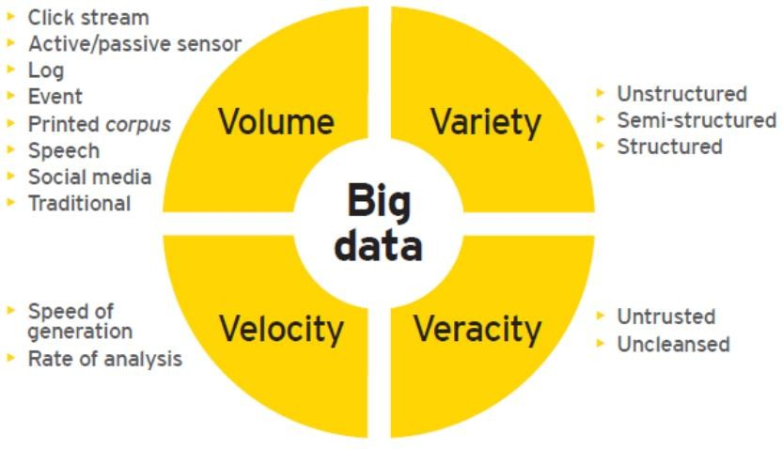
Characteristics of Big Data
Big Data: 4V’s
Not just a matter of volume

Slide 20
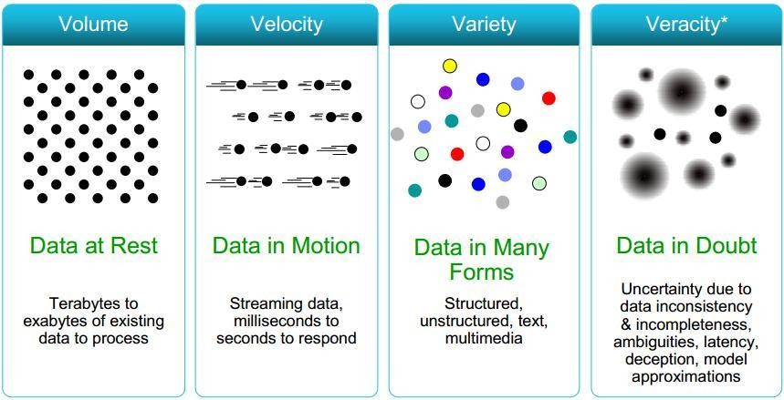
Characteristics of Big Data
Big Data: 4V’s

Slide 21
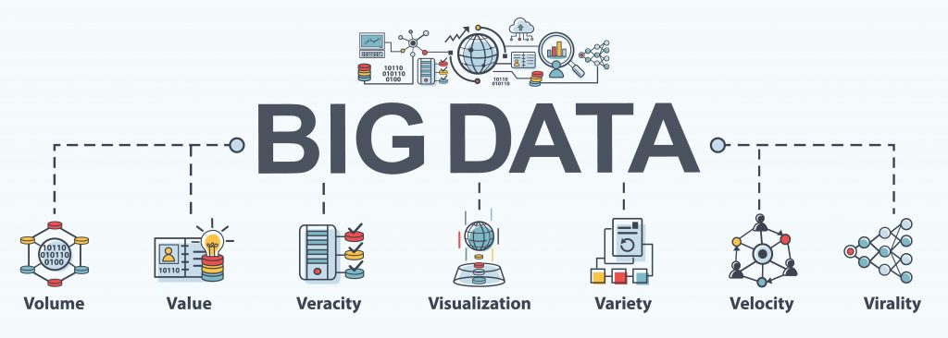
Big Data Characteristics
Volume represents the volume i.e. amount of data that is growing at a high rate i.e. data volume in Petabytes.

Slide 22
Big Data Characteristics
Value refers to turning data into value. By turning accessed big data into values, businesses may generate revenue.

Slide 23
Big Data Characteristics
Veracity refers to the uncertainty of available data. Veracity arises due to the high volume of data that brings incompleteness and inconsistency.

Slide 24
Big Data Characteristics
Visualization is the process of displaying data in charts, graphs, maps, and other visual forms.

Slide 25
Big Data Characteristics
Variety refers to the different data types i.e. various data formats like text, audios, videos, etc.

Slide 26
Big Data Characteristics
Velocity is the rate at which data grows. Social media contributes a major role in the velocity of growing data.

Slide 27
Big Data Characteristics
Virality describes how quickly information gets spread across people to people (P2P) networks.

Slide 28

Volume
As it follows from the name, big data is used to refer to enormous amounts of information.
We are talking about not gigabytes but terabytes and petabytes of data.
The IoT (Internet of Things) is creating exponential growth in data.
The volume of data is projected to change significantly in the coming years.
Hence, 'Volume' is one characteristic which needs to be considered while dealing with Big Data.
Volume
[ Data at Rest ]
Terabytes, Petabytes
Records/Arch
Table/Files
Distributed

Slide 29
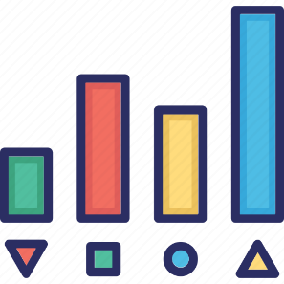
Variety
Variety refers to heterogeneous sources and the nature of data, both structured and unstructured.
Data comes in different formats – from structured, numeric data in traditional databases to unstructured text documents, emails, videos, audios, stock ticker data and financial transactions.
This variety of unstructured data poses certain issues for storage, mining and analysing data.
Organizing the data in a meaningful way is no simple task, especially when the data itself changes rapidly.
Another challenge of Big Data processing goes beyond the massive volumes and increasing velocities of data but also in manipulating the enormous variety of these data.
Variety
[ Data in many Forms ]
Structured
Unstructured
Text
Multimedia

Slide 30

Veracity
Veracity describes whether the data can be trusted.
Veracity refers to the uncertainty of available data.
Veracity arises due to the high volume of data that brings incompleteness and inconsistency.
Hygiene of data in analytics is important because otherwise, you cannot guarantee the accuracy of your results.
Because data comes from so many different sources, it’s difficult to link, match, cleanse and transform data across systems.
However, it is useless if the data being analysed are inaccurate or incomplete.
Veracity is all about making sure the data is accurate, which requires processes to keep the bad data from accumulating in your systems.
Veracity
[ Data in Doubt ]
Trustworthiness
Authenticity
Accurate
Availability

Slide 31

Velocity
Velocity is the speed in which data is grows, process and becomes accessible.
A data flows in from sources like business processes, application logs, networks, and social media sites, sensors, Mobile devices, etc.
The flow of data is massive and continuous.
Most data are warehoused before analysis, there is an increasing need for real-time processing of these enormous volumes.
Real-time processing reduces storage requirements while providing more responsive, accurate and profitable responses.
It should be processed fast by batch, in a stream-like manner because it just keeps growing every years.
Velocity
[ Data in Motion ]
Streaming
Batch
Real / Near Time
Processes

Slide 32

Value
It refers to turning data into value. By turning accessed big data into values, businesses may generate revenue.
Value is the end game. After addressing volume, velocity, variety, variability, veracity, and visualization – which takes a lot of time, effort and resources – you want to be sure your organization is getting value from the data.
For example, data that can be used to analyze consumer behavior is valuable for your company because you can use the research results to make individualized offers.
Value
[ Data into Money ]
Statistical
Events
Correlations

Slide 33

Visualization
Big data visualization is the process of displaying data in charts, graphs, maps, and other visual forms.
It is used to help people easily understand and interpret their data at a glance, and to clearly show trends and patterns that arise from this data.
Raw data comes in a different formats, so creating data visualizations is process of gathering, managing, and transforming data into a format that’s most usable and meaningful.
Big Data Visualization makes your data as accessible as possible to everyone within your organization, whether they have technical data skills or not.
Visualization
[ Data Readable ]
Readable
Accessible
Presentation
Visual Forms

Slide 34

Virality
Virality describes how quickly information gets spread across people to people (P2P) networks.
It is measures how quickly data is spread and shared to each unique node.
Time is a determinant factor along with rate of spread.
Virality
[ Data Spread ]
P2P
Shared
Rate of Spread

Slide 35
Characteristics of Big Data
What is more important?
The “Big”
The “Data”
—Both
—Neither
Big Data: V4+VALUE
Volume: Terabyte(1012), Petabyte(1015), Exabyte(1018), Zettabyte (1021)
Variety: Structured, semi-structured, unstructured; Text, image, audio, video, record
Velocity: Periodic, Near Real Time, Real Time
Veracity: Quality of the data can vary greatly
Value: Big data can generate huge competitive advantages

Slide 36
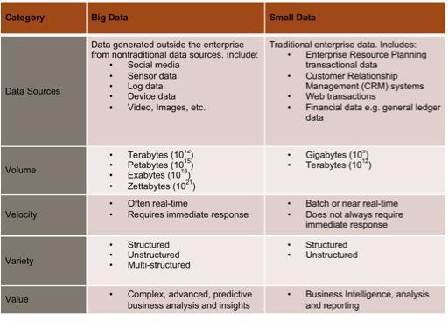
Characteristics of Big Data

Slide 37
Characteristics of Big Data
Big Data: 5V’s
Volume (Scale) Variety (Complexity) Velocity (Speed) Veracity (Uncertainty) Value

Slide 38
Traditional Versus Big Data Approach
OLTP: Online Transaction Processing
DBMSs
OLAP: Online Analytical Processing
Data Warehousing
RTAP: Real-Time Analytics Processing
Big Data Architecture & Technology

Slide 39
Issues in Big data
Scalability
Heterogeneity and Incompleteness Precision
Human Collaboration Privacy
Data Visualization
Data Redundancy and Compression

Slide 40
Introduction to Big Data
Risks and Challenges of Big Data
Performance, performance, performance!
Data grows faster than energy on chip
Efficiency
Scalability
Effectiveness
Heterogeneity
Flexibility
Privacy
Costs

Slide 41
Introduction to Big Data
Benefits of Big Data Processing
Businesses can utilize outside intelligence while taking decisions
Improved customer service
Early identification of risk to the product/services, if any Better operational efficiency

Slide 42
What to do with these data?
Aggregation and Statistics
Data warehouse and OLAP
Indexing, Searching, and Querying
Keyword based search
Pattern matching (XML/RDF-Resource Description Framework)
Knowledge discovery
Data Mining
Statistical Modeling

Slide 43
Smart Decisions
Why Big Data analysis Should Matter to Organization?
Time Reduction
Cost Reduction
New product offerings
Personalized offerings, etc.

Slide 44
Characteristics of Big Data
Data Sources

Slide 45
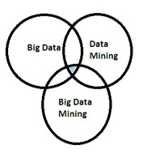
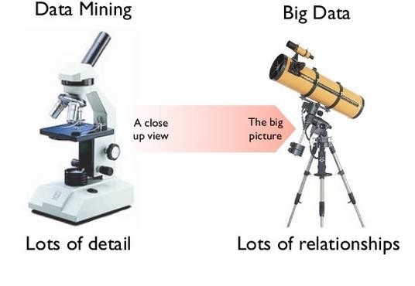
Data Mining V/s Big Data
How to manage very large amounts of data and extract value and knowledge from them?
Big Data Mining
Big data is the asset and data mining is the "handler" of that is used to provide beneficial results.

Slide 46
What’s driving Big Data
Complexity
Optimizations and predictive analytics Complex statistical analysis
Querying and reporting - Data mining techniques
Business Value – Application
Querying and reporting - Data mining techniques Crime Prevention in Los Angeles
—Diagnosis and treatment of genetic diseases
—Investments in the financial sector
—Generation of personalized advertising
—Astronomical discoveries

Slide 47
Why Big Data Mining?
Technology advances now make it possible to analyze entire data sets and not just subsets.
Every interaction rather than just every transaction can be analyzed.
Analysis of multi-structured data may produce additional insight for making smart decisions from organizations point of view.

Slide 48
Technology for Big Data Analytics
Horizontal scaling involves distributing the workload across multiple
independent machines to improve processing capability.
Vertical Scaling involves installing more processors, more memory and faster hardware typically within a single server.
Peer to Peer Network is decentralized and distributed network architecture involve millions of machines (peers) connected in a network serve and consume
resources.
Message passing Interface(MPI) is communication scheme used to
communicate and exchange data between peers.
Broadcasting messages in peer to peer network is cheaper but the aggregation of data/results is much expensive.

Slide 49
Case Study of Big Data Solutions
Case Study 1
Wordcount Example
Case Study 2
Clickstream Example
Website informs public about various products and services Clickstream data is generated when the customers/visitors interact thorugh website.

Slide 50
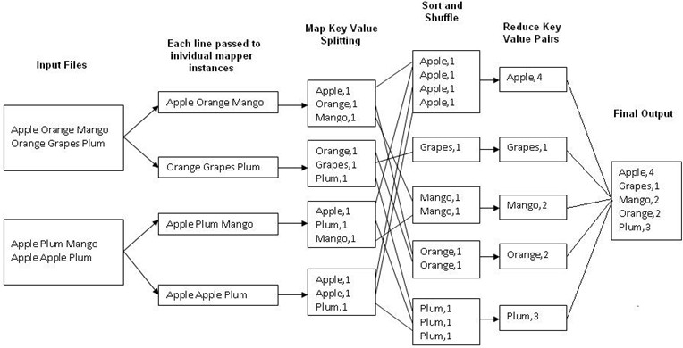
Word Count Example
MapReduce (Data processing engine)

Slide 51
Introduction to Big Data
Application in Diverse Sectors
Crime Prevention
Diagnosis and treatment of genetic diseases
Investments in the financial sector
Generation of personalized advertising
Astronomical discoveries

Slide 52
Introduction to Big Data
Use Cases
Sector | Challenge | New Data | What’s Possible
Healthcare | Expensive office visits | Remote patient monitoring | Preventive care, reduced hospitalization
Manufacturing | In-person support | Product sensors | Automated diagnosis, support
Location-Based Services | Based on position | Real time location data | Geo-advertising, traffic, local search
Public Sector | Standardized services | Citizen surveys | Tailored services, cost reductions
Retail | One size fits all marketing | Social media | Sentiment analysis segmentation

Slide 53
Introduction to Big Data
The big data process (to make effective strategic decisions exploiting the availability of big data)
Acquisition
Requires:—selection,—filtering,—Metadata generation,—managing provenance
Extraction
Requires:—transformation, normalization, cleaning, aggregation, error handling
Integration
Requires: standardization, conflict management, reconciliation, mapping definition
Analysis
Requires: exploration, data mining,—machine learning,—visualization
Interpretation
Requires: Knowledge of the domain, Knowledge of the provenance,
Identification of patterns of interest, Flexibility of the process
Decision—
Requires: managerial skills, continuous improvement of the process

Slide 54
Introduction to Big Data
The New Software Stack
New programming environments designed to get their parallelism not from a supercomputer but from computing clusters
Bottom of the stack: distributed file system (DFS)
We have a winner!

Slide 55
Introduction to Big Data
The New Software Stack - —On the top of Hadoop
Hundreds of different (high-level) progg solutions
Two main scenarios:
Analytics (batch/near-real-time): collecting, transforming, and modeling data with the goal of discovering useful information and supporting decision-making
Interactive (real-time): processing data and returning the results sufficiently quickly to affect the environment at that time
e-commerce, search engines, booking, …

Slide 56
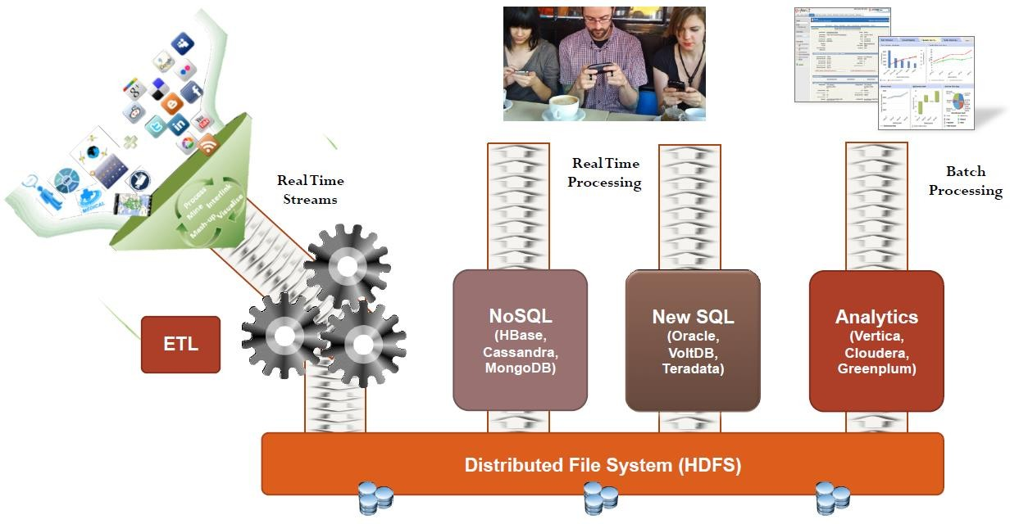
The Big Data flow
The Big Data flow
—

Slide 57
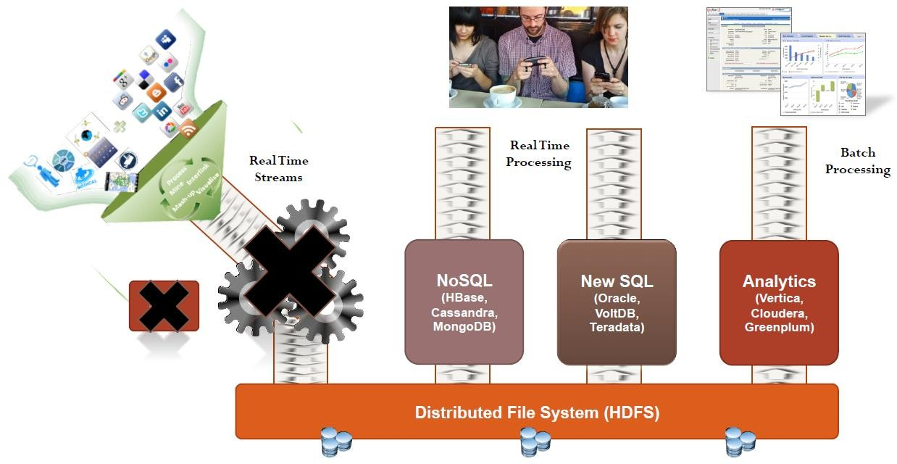
A recent trend
A recent trend—

Slide 58
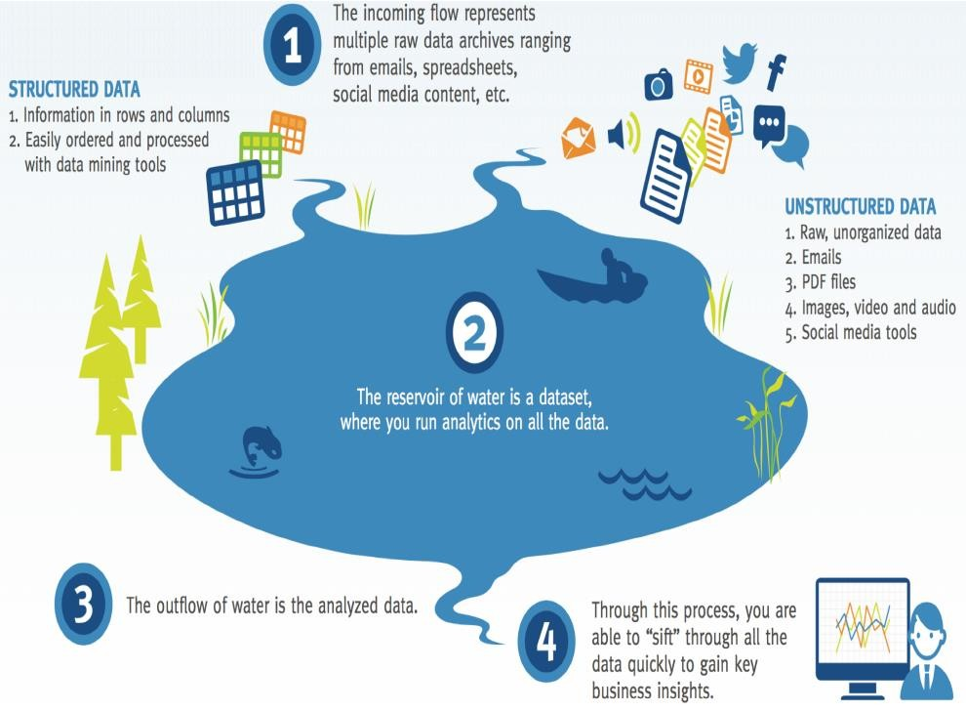
Data lake
Data lake

Slide 59
Techniques for big data analysis
Techniques for big data analysis
Extract, transform, and load (ETL)
Data fusion and data integration
Distributed file system
NoSQL database systems
Cloud computing
Analytics
Data mining
Association rule learning
Classification
Cluster analysis
Regression
Machine learning
Supervised learning
Unsupervised learning
Crowdsourcing

Slide 60
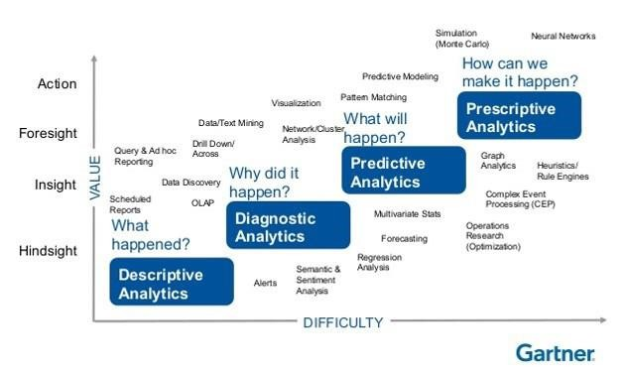
Goals of analytics
Goals of analytics

Slide 61
Data scientist: a brand new profession
Data scientist: a brand new profession
Data Scientist: The in-demand Job of the 21st Century
[Harward Business Review 2013]
Data scientist? A guide to 2015's hottest profession
[Mashable 2015]
It’s official – data scientist is the best job in America”
[Forbes, 2016]

Slide 62
Skills of data scientists
Data scientist The in-demand Job of the 21st Century requires
A mixture of multidisciplinary skills ranging from an intersection of mathematics, statistics, computer science,
communication and business.
Finding a data scientist is hard.
Finding people who understand who a data scientist is, is equally hard. So here is a little cheat sheet on who the modern data scientist really is.
Math and Statistics | Programming and Database
Machine Learning | Computer Science Fundamentals
Statistical Modeling | Scripting Language e.g Python
Experiment Design | Statistical Computing Package e.g R
Bayesian Interface | Database SQL and NoSQL
Supervised Learning: DTree, random forests, logistic regression | Relational Algebra
Unsupervised Learning: clustering, dimensionality reduction | Parallel Databases and Parallel Query Processing
Optimization: Gradient descent and variants | MapReduce Concepts
Hadoop and Hive/Pig
Custom Reducers
Experience with xaaS like AWS
Domain Knowledge and Soft Skills | Communication and Visualization
Passionate about the business | Able to engage with senior management
Curious about data | Story telling skills
Influence without authority | Translate data-driven insights into decision and actions
Hacker mindset | Visual art design
Problem Solver | R Packages like ggplot or lattice
Strategic, Proactive, creative, innovative and collaborative | Knowledge of any of visualization tools e.g. Flare, D3.js, Tableau

Slide 63
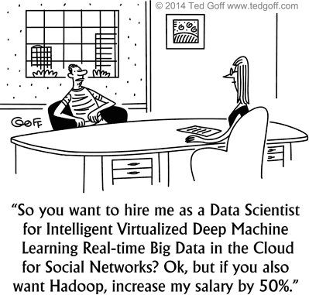
After this course

Slide 64
After this course
Conclusions
We live in the era of Big Data
Wide range of availability in different areas
Big opportunities to solve big problems
They can create value
The challenge is how to manage and use them
New technologies are needed
Methodological aspects are important
A rapidly evolving area
Data scientists: the current hottest profession in IT

Slide 65
Characteristics of Big Data
Module 1: Introduction to Big data
Module 2 : Hadoop
Module 3 : NoSQL
Module 4: MapReduce and New S/w Stack Module 5 : Finding similar Items
Module 6 : Mining Data Stream
Module 7 : Link Analysis
Module 8: Frequent item set Module 9 : Clustering
Module 10 : Recommendation system Module 11: Mining Social-Networks Graphs

Slide 66
References
Text Books:
Anand Rajaraman and Jeff Ullman “Mining of Massive Datasets”, Cambridge University Press,
Alex Holmes “Hadoop in Practice”, Manning Press, DreamTech Press.
Dan McCreary and Ann Kelly “Making Sense of NoSQL” – A guide for managers and the rest of us, Manning Press.
—"Big Data: The next frontier for innovation, competition, and productivity". Rapporto McKinsey&Company, 2012.
—"Challenges and Opportunities with Big Data". A community white paper developed by leading researchers
across the United States, 2012.
—"Taming The Big Data Tidal Wave: Finding Opportunities in Huge Data Streams with Advanced Analytics". Bill Franks, John Wiley & Sons, 2012.
References:
Bill Franks , “Taming The Big Data Tidal Wave: Finding Opportunities In Huge Data Streams With
Advanced Analytics”, Wiley
Chuck Lam, “Hadoop in Action”, Dreamtech Press
Judith Hurwitz, Alan Nugent, Dr. Fern Halper, Marcia Kaufman, “Big Data for Dummies”, Wiley India
Michael Minelli, Michele Chambers, Ambiga Dhiraj, “Big Data Big Analytics: Emerging Business Intelligence And Analytic Trends For Today's Businesses”, Wiley India
Phil Simon, “Too Big To Ignore: The Business Case For Big Data”, Wiley India
Paul Zikopoulos, Chris Eaton, “Understanding Big Data: Analytics for Enterprise Class Hadoop and Streaming Data’, McGraw Hill Education.
Boris Lublinsky, Kevin T. Smith, Alexey Yakubovich, “Professional Hadoop Solutions”, Wiley India.
66

Slide 67


Thank You.

